Slide 1
B. Tech ECE PROJECT 2 -Review 2
IoT-Enabled Fall Detection System for the Elderly Using Machine Learning
By -:
Aiyushi Srivastava
Tushar Pati Tripathi
Rohan Joshi
Faculty Guide-:
Dr.Ravi Kumar C.V.

Slide 2
Contents
01
02
03
04
05
06
07
08
09
10
11
12
13
INTRODUCTION
Literature Review
Problem Statement
Relevance of the problem statement w.r.t to SDG
Project Objectives
Methodology
Components Required
Results
Social and Environmental impact
Workplan
Cost Analysis
References

Slide 3
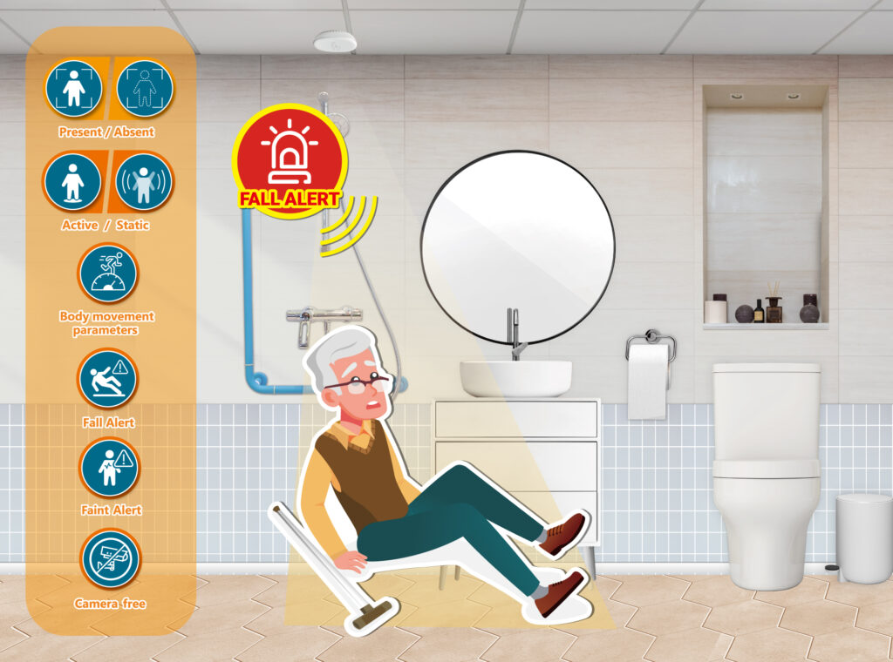
Introduction
Fall detection is a major challenge in the public health care domain, especially for the elderly, and reliable surveillance is a necessity to mitigate the effects of falls. The technology and products related to fall detection have always been in high demand within the security and the health-care industries. An effective fall detection system is required to provide urgent support and to significantly reduce the medical care costs associated with falls.
About 20-30% of older adults (≥ 65 years old) experience one or more falls each year, and falls are associated with substantial burden to the health care system, individuals, and families from resulting injuries, fractures, and reduced functioning and quality of life. Many interventions for preventing falls have been studied, and their effectiveness, factors relevant to their implementation, and patient preferences may determine which interventions to use in primary care.

Slide 4
Literature Review
S No | Publisher | Focus/Scope of Paper | Methodology | Test Data | Results | Merits & Demerits | Future Scope
1 | PubMed | Falls prevention interventions for older adults | Systematic review and meta-analysis | Multiple previous studies | Identifies effective fall prevention strategies | Merit: Comprehensive review; Demerit: No real-time implementation | Development of personalized intervention strategies
2 | PubMed | Multifactorial assessment for fall prevention in community and emergency settings | Systematic review and meta-analysis | Multiple studies analyzed | Effectiveness of interventions in emergency settings | Merit: Broad study coverage; Demerit: No hardware implementation | Enhancing real-time fall detection in emergency settings
3 | MDPI | Risk propagation in emergency logistics network | Mathematical modeling and simulations | Simulated data | Identifies risk propagation in emergency logistics | Merit: Focus on risk management; Demerit: No specific application to fall detection | Application to healthcare logistics for fall response
4 | Science Direct | Survey on fall detection principles and approaches | Review of existing fall detection methodologies | Multiple previous studies | Comparison of different fall detection techniques | Merit: Comprehensive survey; Demerit: Lacks practical implementation | AI-based hybrid fall detection techniques
5 | PubMed | Step and spin turns classification using wireless gyroscopes for fall risk assessments | Wearable gyroscope-based classification | Test subjects performing movements | Accurate classification of movements related to fall risk | Merit: Precise motion classification; Demerit: Requires wearables | Improving real-time analysis for fall prediction

Slide 5
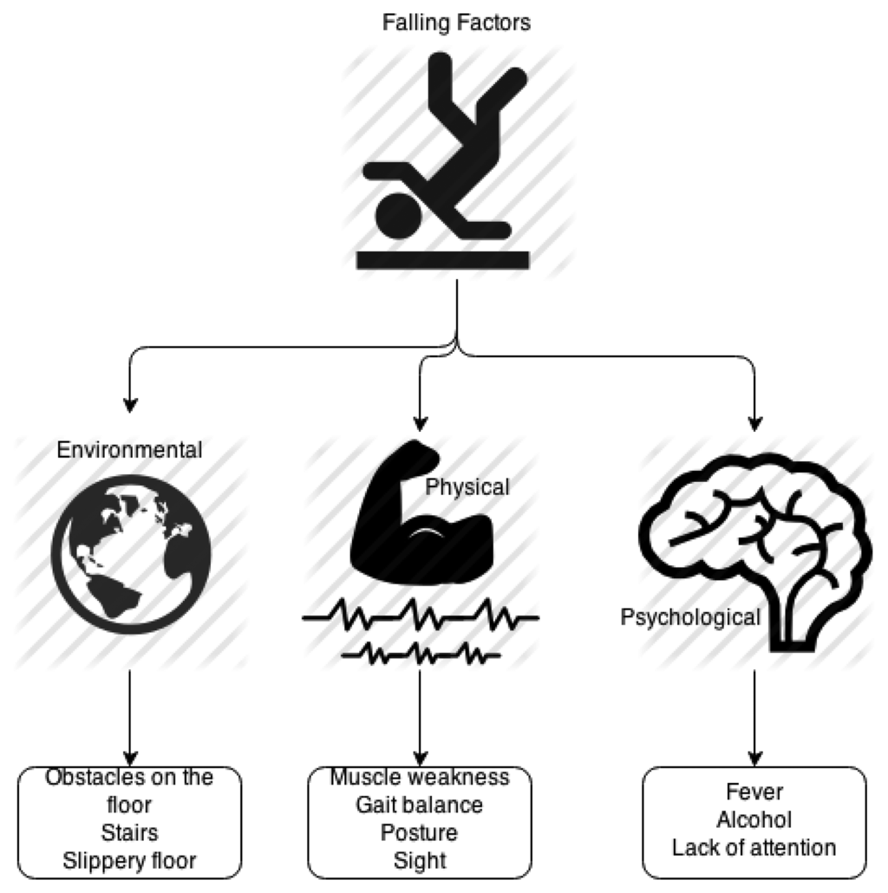
Problem Statement
Elderly individuals, particularly those living alone or with limited supervision, are at high risk of falls, which can lead to serious injuries, disabilities, or even fatalities. Traditional methods of fall detection, such as manual monitoring or emergency buttons, are often ineffective due to delays in response or the inability of the person to call for help. There is a need for an automatic, real-time fall detection system that can promptly alert caregivers or emergency services to ensure quick assistance and minimize health risks.
Solution:
A smart fall detection system using IoT and AI-based techniques can address this issue effectively. The proposed solution includes:
Sensor-Based Approach
Computer Vision-Based Approach
Hybrid Approach
Alert Mechanism
Machine Learning & AI

Slide 6

Relevance of the problem statement w.r.t to SDG
The Fall Detection System for the elderly aligns with several Sustainable Development Goals (SDGs) set by the United Nations, particularly those focused on safety, sustainability, and innovation. Below are some of the key SDGs:
SDG 3: Good Health and Well-being
SDG 9: Industry, Innovation, and Infrastructure
SDG 10: Reduced Inequalities
SDG 11: Sustainable Cities and Communities
SDG 8: Decent Work and Economic Growth
SDG 12: Responsible Consumption and Production Target

Slide 7
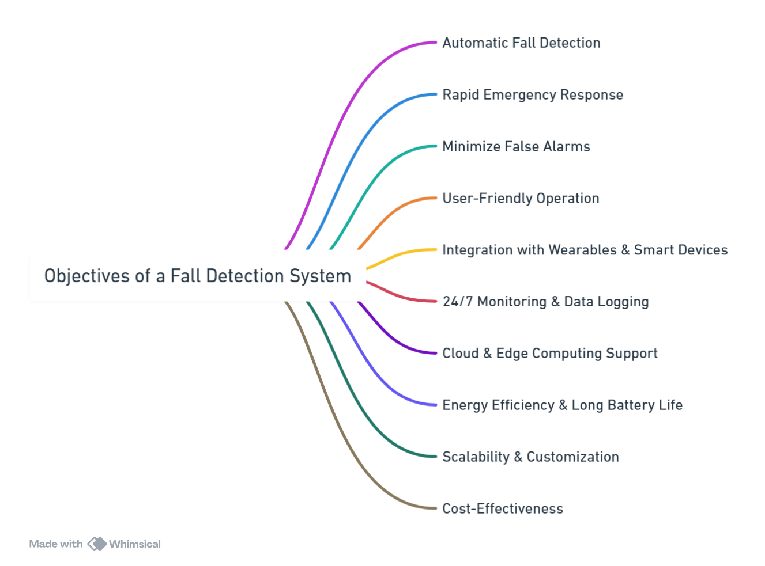
Objectives

Slide 8
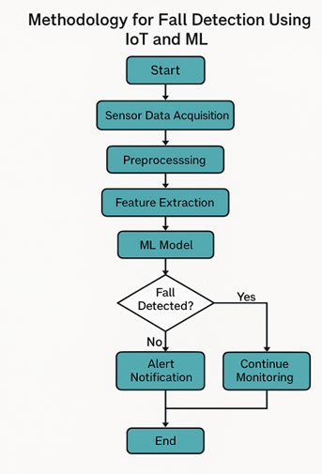
Methodology
The methodology of this Project includes the following key steps:
1. Sensor Integration:
The system uses the MPU6050 sensor module, which includes a gyroscope and accelerometer to detect movement and orientation.
The Arduino Uno microcontroller processes data from the sensor.
Data Collection & Processing:
Acceleration and angular velocity are calculated from the MPU6050.
The sum of acceleration vector and angular velocity is analyzed to determine potential falls.
Threshold-Based Fall Detection: A Lower Fall Threshold (LFT) is established to identify sudden decreases in acceleration. An Upper Fall Threshold (UFT) is established to detect high-impact forces.
Alert Mechanism: Once a fall is detected, an alert is sent through the Blynk Application on a caregiver's phone.
Prototype Testing:
Various test cases, such as front fall, back fall, and side fall, were conducted to verify the system's accuracy.
Adjustments were made based on real-world test data to improve sensitivity and specificity.

Slide 9
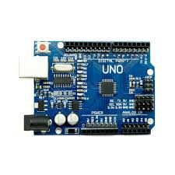
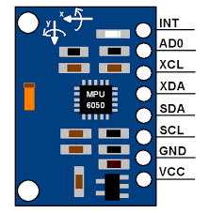


Components Required
Hardware
Arduino Uno
Breadboard
MPU6050 Sensor
BMP280
HC-SR04.
Jumper Wires
Soldering Iron
Soldering material
Software
Arduino IDE
Fritzing
Python
Google Colab

Slide 10
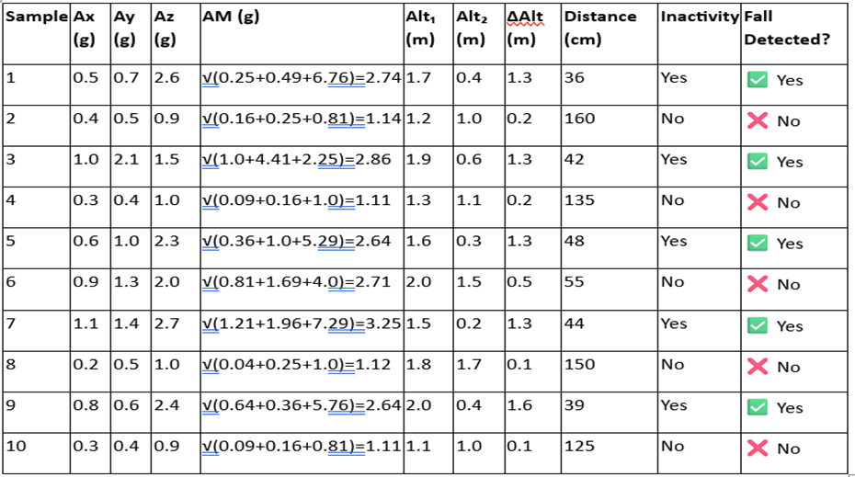
Calculations

Slide 11
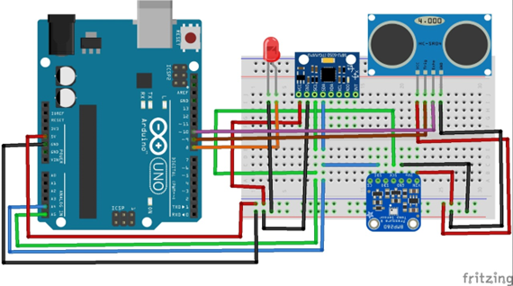
Results
Circuit Diagram of Prototype

Slide 12
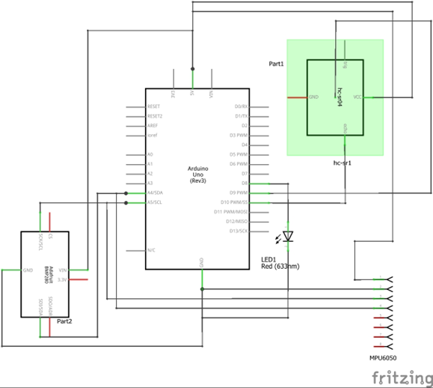
Schematic Diagram of Prototype

Slide 13
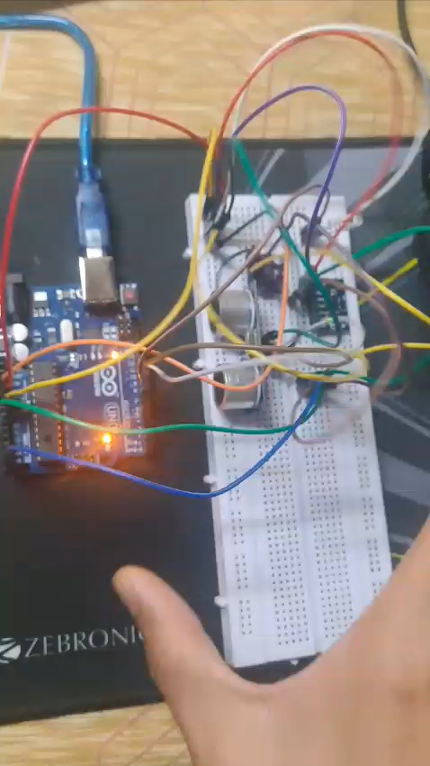
Working of Hardware

Slide 14
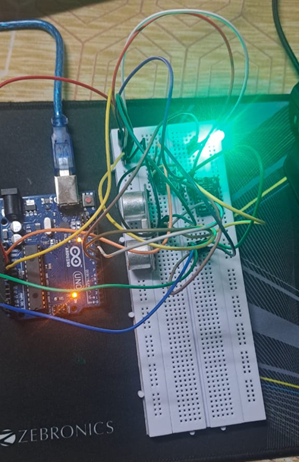
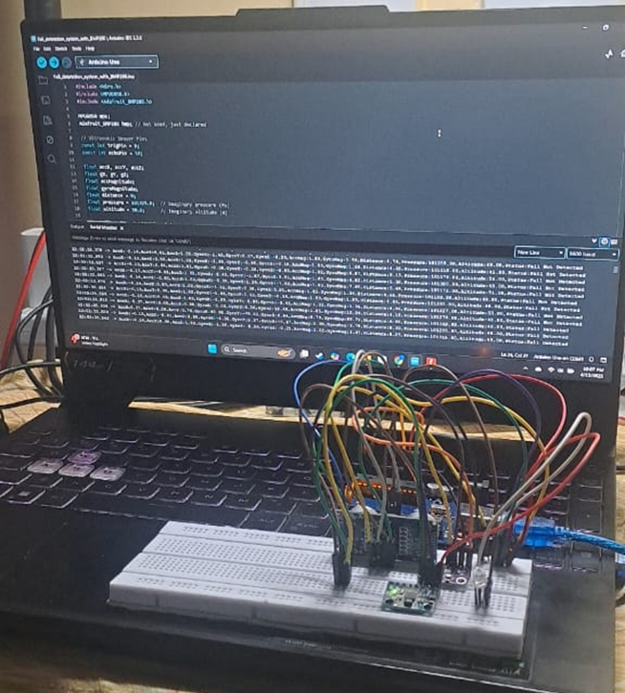
Result

Slide 15
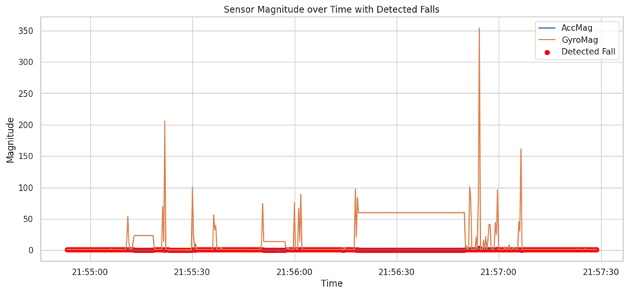
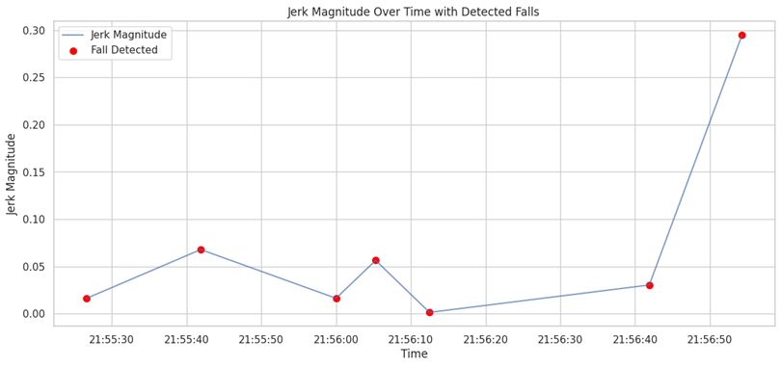
Results

Slide 16
https://colab.research.google.com/drive/1YjFBW7itS95mI8yzmhjLOgvBe5k_g5ZW?usp=sharing
https://colab.research.google.com/drive/1iISlv_X8mO9JT0oTcdeQrEV5wt3nnwu9
https://colab.research.google.com/drive/14zf7Vi4HJqOUoxQRN_oLUb_mnzxjv3F-
https://colab.research.google.com/drive/1V_juopr_eN-W8Gpzo3iCc2jJL25iewuU
Verification of Obtained Result

Slide 17
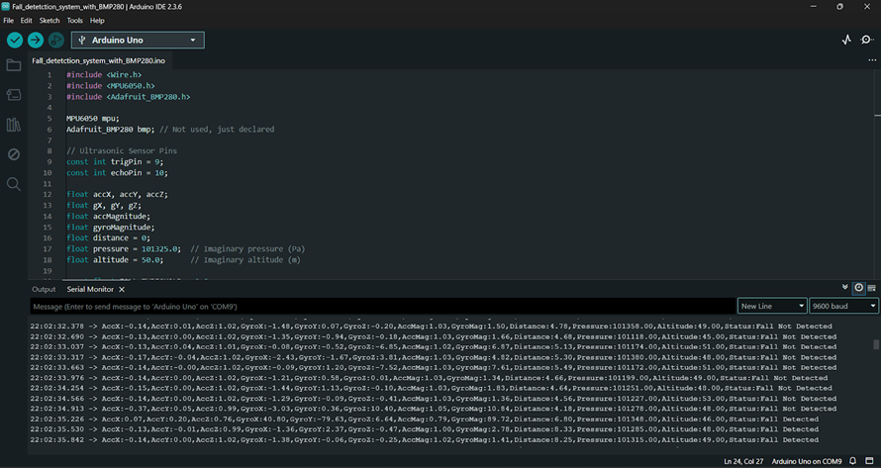
Code

Slide 18
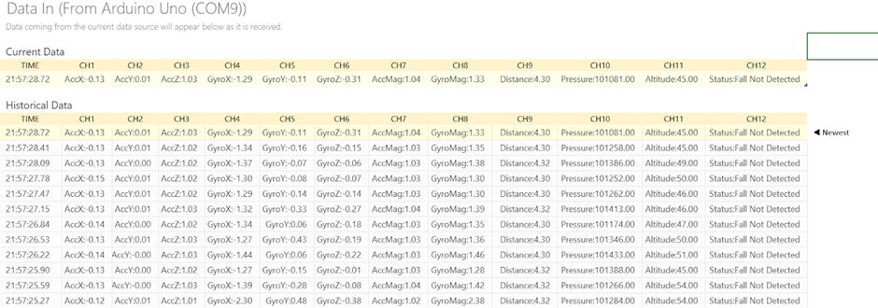
Snapshot of Real-Time Sensor Data Simulation Dataset

Slide 19
Social and Environmental Impact
SOCIAL IMPACT
1. Improvement in Elderly Care and Autonomy
2. Timely Medical Response and Better Results
3. Relief for Caregivers and Healthcare Workers
4. Social Inclusion through Technology
ENVIRONMENTAL IMPACT
1. Low Energy Consumption
2. Low Carbon Footprint due to Healthcare Logistics
3. Environmental Materials and Waste Disposal
4. Scalability Without Ecological Drawback

Slide 20
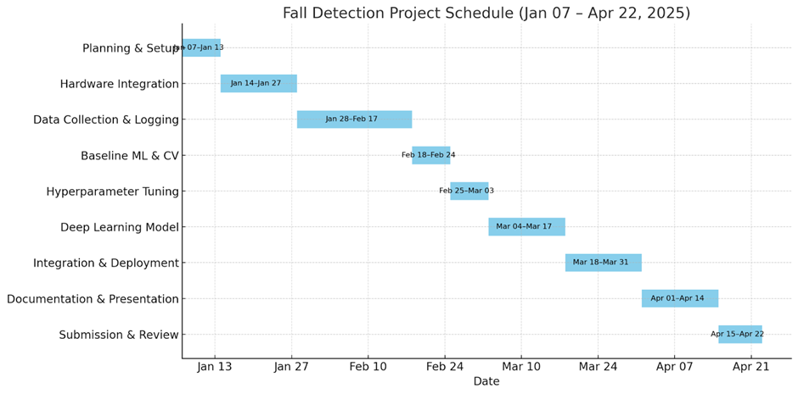
Workplan

Slide 21
Cost Analysis
Component | Quantity | Cost per Unit (INR) | Total (INR)
Arduino Uno / ESP32 | 1 | ₹580 | ₹580
MPU6050 (Accelerometer + Gyro) | 1 | ₹210 | ₹210
BMP280 (Barometric Sensor) | 1 | ₹165 | ₹165
HC-SR04 (Ultrasonic Sensor) | 1 | ₹83 | ₹83
Buzzer / LED Indicators | 1 set | ₹83 | ₹83
Miscellaneous | 3 | ₹165, ₹165, ₹250 | ₹580
Total Hardware Cost per Unit = ₹1,784

Slide 22
In this project, we incorporated a network of IoT sensors—mainly accelerometers, gyroscopes, and altitude sensors—attached to a microcontroller such as the Arduino Uno to constantly monitor the motion and posture of the user. Through calculation of important physical parameters including acceleration magnitude and change in altitude and combining the same with context-aware features such as inactivity and height to the ground, the system is able to differentiate between normal activity and possible falls effectively. In summary, the combination of IoT and machine learning in fall detection systems offers a strong, smart, and life-saving solution in contemporary healthcare. Although the present implementation shows encouraging outcomes, it also provides a foundation for future enhancements, including wearable miniaturization, incorporation with health monitoring applications, real-time GPS location tracking, and utilization of deep learning models for even more precise classification. This system is not only an innovation in technology but a worthy contribution to the well-being and autonomy of old people everywhere. Overall, this IoT- and machine learning-based Fall Detection System is more than a technological project—it's a socially influential innovation. It creates a space for healthcare and technology to connect on a bigger level, presenting an intelligent, scalable, and lifesaving system. With ongoing improvements, such as enhanced sensor fusion, incorporation of deep learning, and the incorporation of intelligent wearables, these types of systems can be taken as regular instruments in the world effort toward the better care of elderly patients and active monitoring of health.
Conclusion

Slide 23
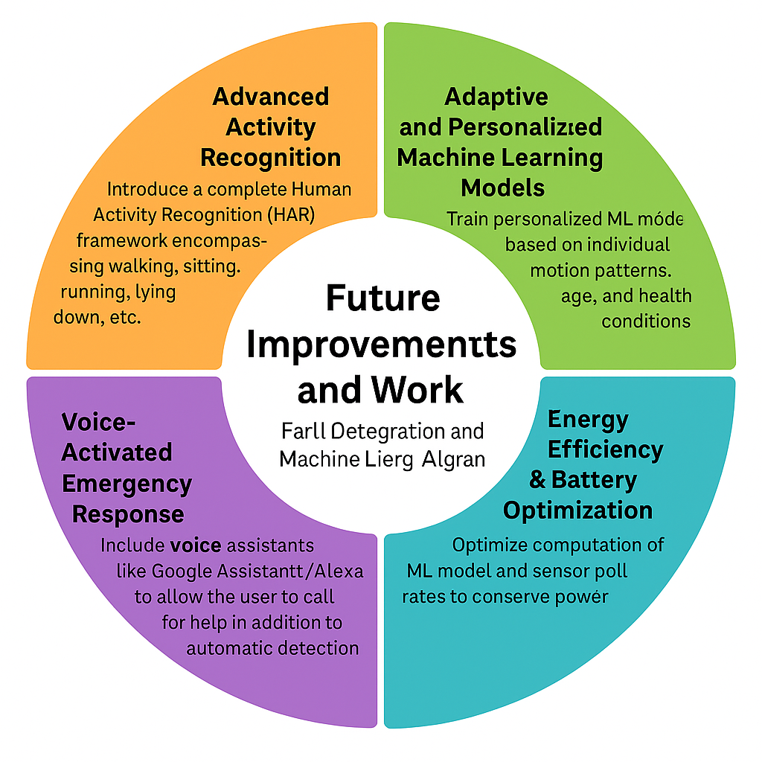
Future work
Here are comprehensive Future Improvements and Work plans for the Fall Detection System using IoT Integration and Machine Learning Algorithm based on your report:
1. Advanced Activity Recognition- Introduce a complete Human Activity Recognition (HAR) framework encompassing walking, sitting, running, lying down, etc.
2. Adaptive and Personalized Machine Learning Models- Train personalized ML models based on individual motion patterns, age, and health conditions.
3. Energy Efficiency & Battery Optimization-Optimize computation of ML model and sensor poll rates to conserve power.
4. Privacy & Security Improvements- Provide end-to-end encryption of personal and sensor data
5. Voice-Activated Emergency Response- Include voice assistants like Google Assistant/Alexa to allow the user to call for help in addition to automatic detection.

Slide 24
Contributions
Tushar Tripathi
Aiyushi Srivastava
Rohan Joshi
Sensor integration
Circuit design
PCB circuit design
Trained the machine learning models
Real-time data visualization
Integration with Arduino Uno
Literature Review
Flow charts
Methodological framework
Theory matter
Written codes
Visual flow
Circuit diagrams
Sensor information

Slide 25
References
FALL DETECTION SYSTEM https://naac.kct.ac.in/1/ssr/1_3_4/projects/17BIT014.pdf
Real-Time Fall Detection using ESP32 and AMG8833 Thermal Sensor: A Non-Wearable Approach for Enhanced Safety https://ieeexplore.ieee.org/document/10250598
Falls prevention interventions for community-dwelling older adults: systematic review and meta-analysis of benefits, harms, and patient values and preferences https://pubmed.ncbi.nlm.nih.gov/39593159/
Multifactorial assessment and targeted intervention for preventing falls and injuries among older people in community and emergency care settings: systematic review and meta-analysis https://pubmed.ncbi.nlm.nih.gov/18089892/
Risk Propagation Model and Its Simulation of Emergency Logistics Network Based on Material Reliability https://www.mdpi.com/1660-4601/16/23/4677
A survey on fall detection: Principles and approaches https://www.sciencedirect.com/science/article/abs/pii/S0925231212003153?via%3Dihub
Classifying step and spin turns using wireless gyroscopes and implications for fall risk assessments https://pubmed.ncbi.nlm.nih.gov/25954950/

Slide 26


